Slide 1

Vet Practice Management
Python
flask
psycopg2
Postgres
Alex Dodd

Slide 2
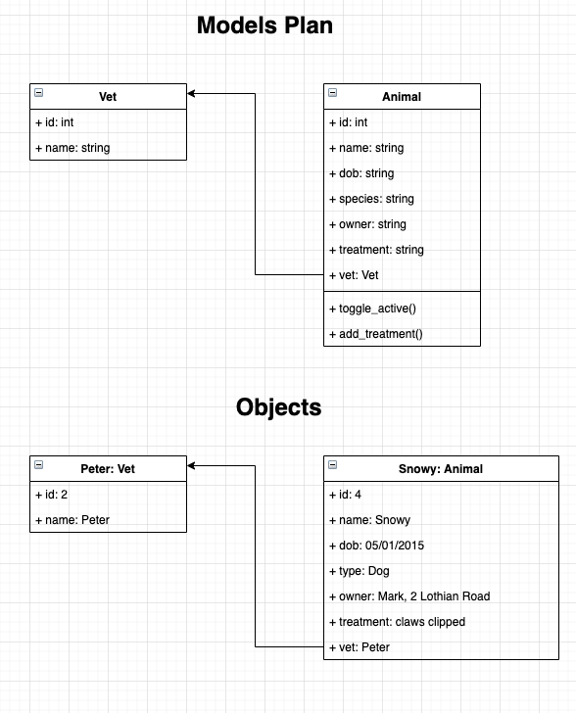
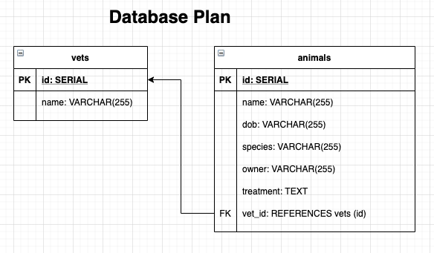
Started with a brief....
Notes:
I can’t stress how much i focussed on the MVP only, and drew out the diagrams even though I thought I won’t need them...

Slide 3
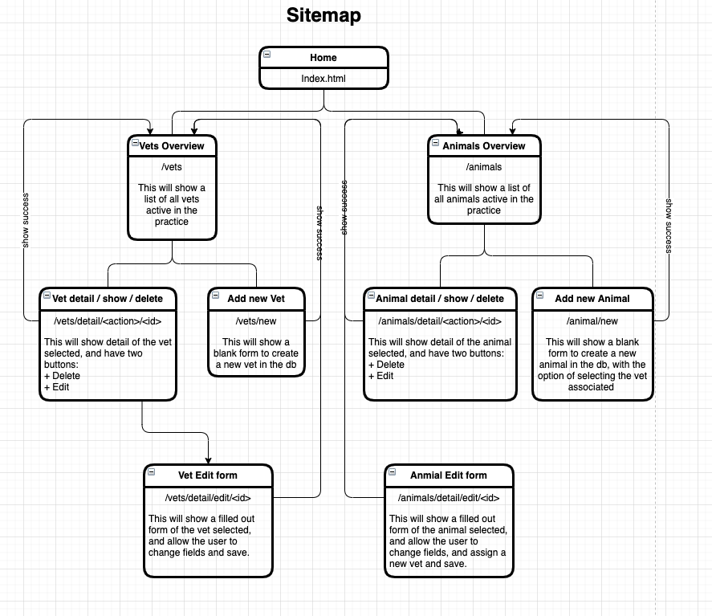
Sitemap proved more helpful than expected
Notes:
The sitemap, was especially hard to conceive in my head before i’d built anything, but i later proved invaluable writing routes, and templates.

Slide 4
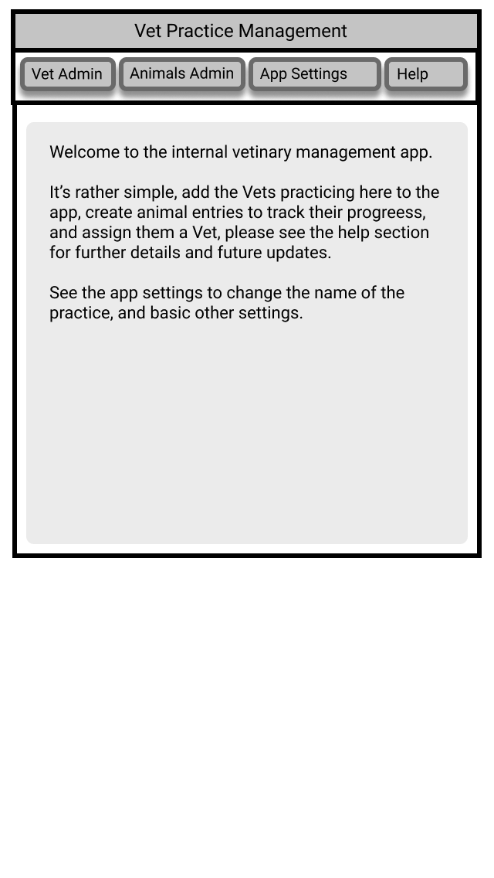
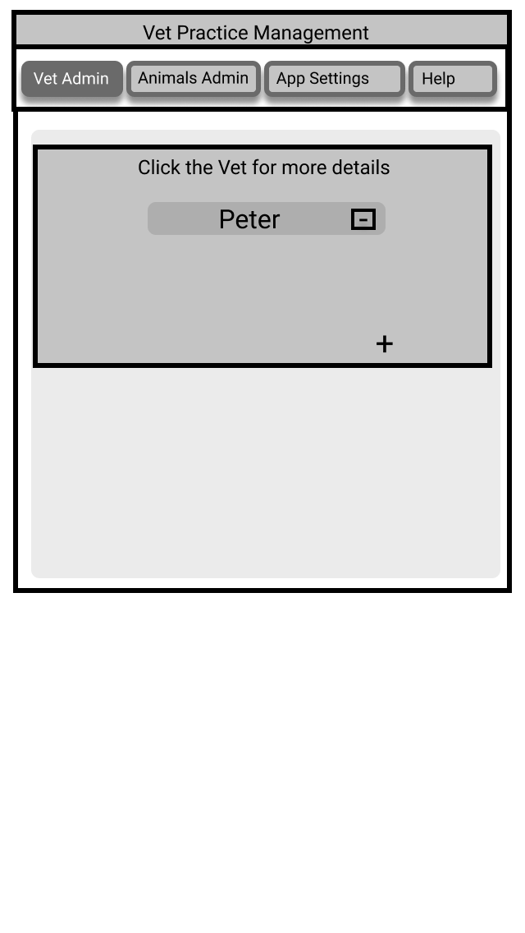
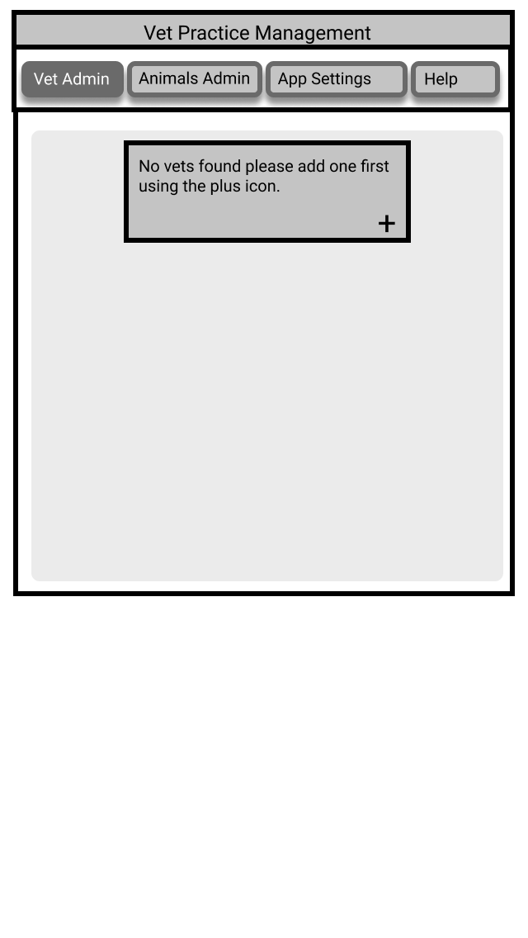
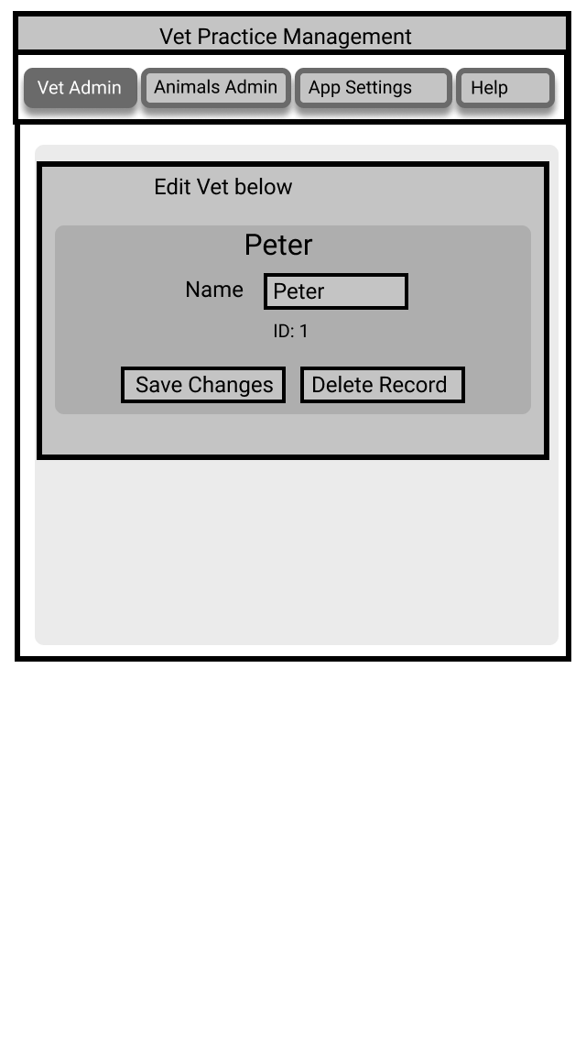
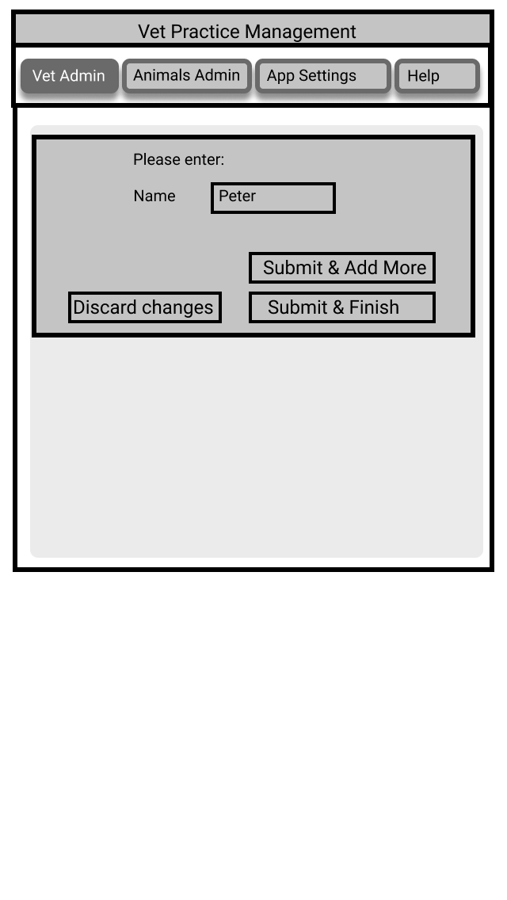
MVP - Wireframed with Figma: Live wireframe
Vet Admin Tab
Notes:
Then i took these and my initial thoughts a put together an interactive wireframe with figma, to give me a feel for what I should try and show where, and how it all might interact, site map helped this along too. Now could my css skills match this masterpiece?

Slide 5
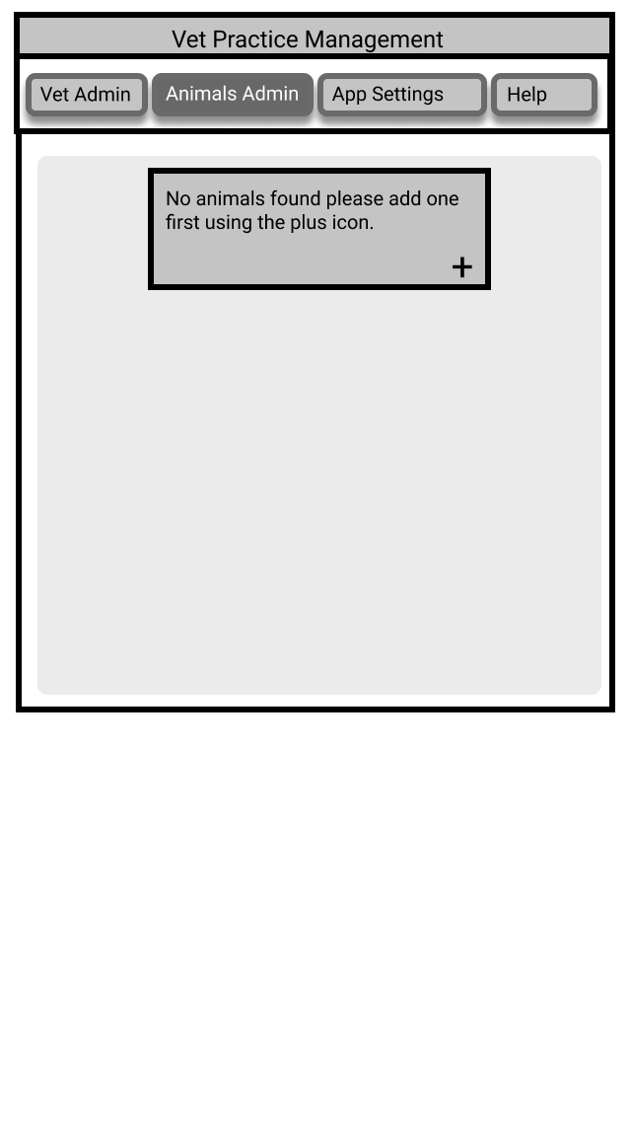
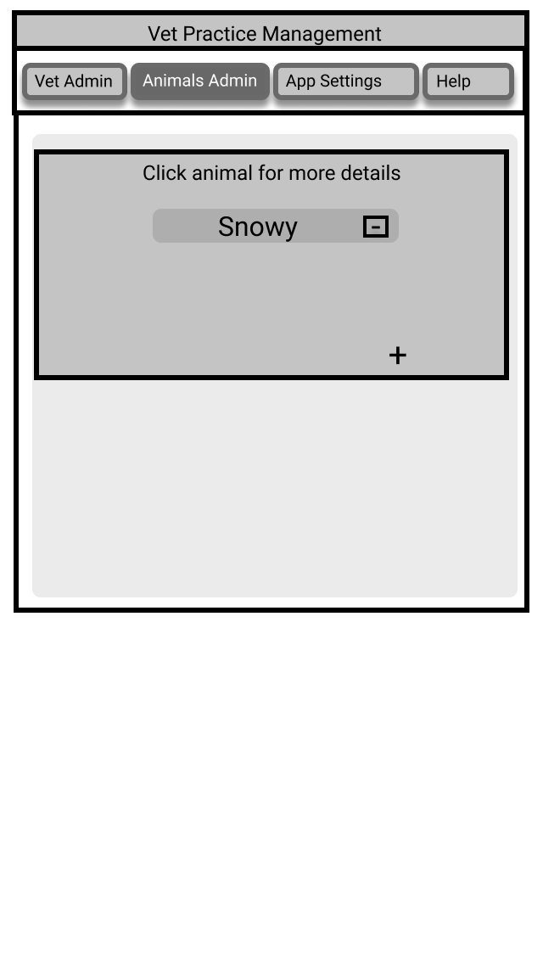
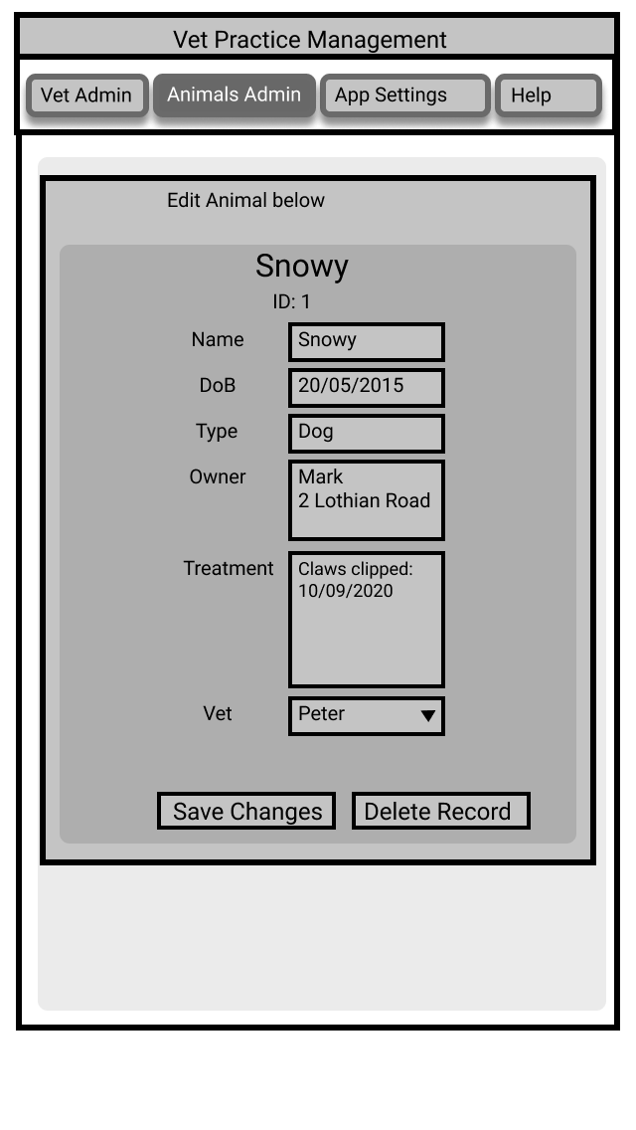
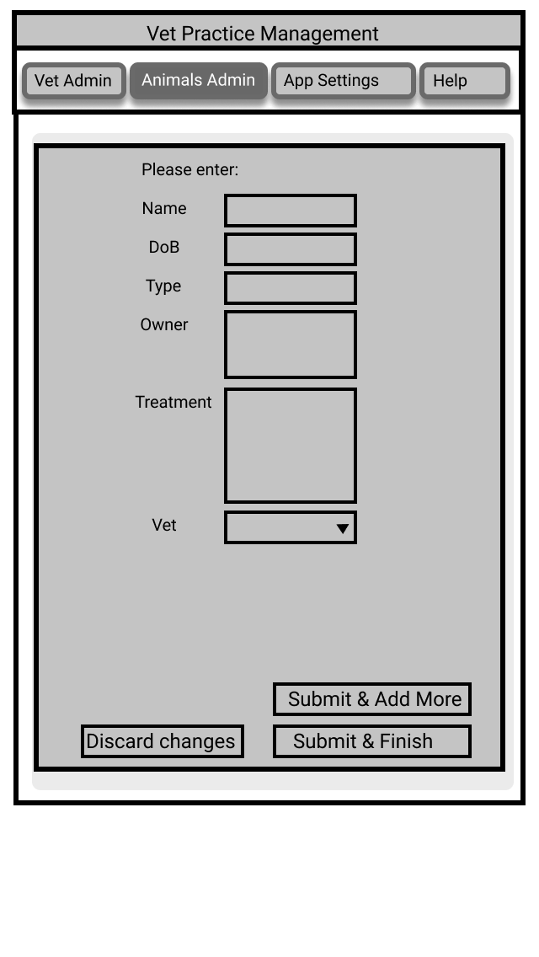
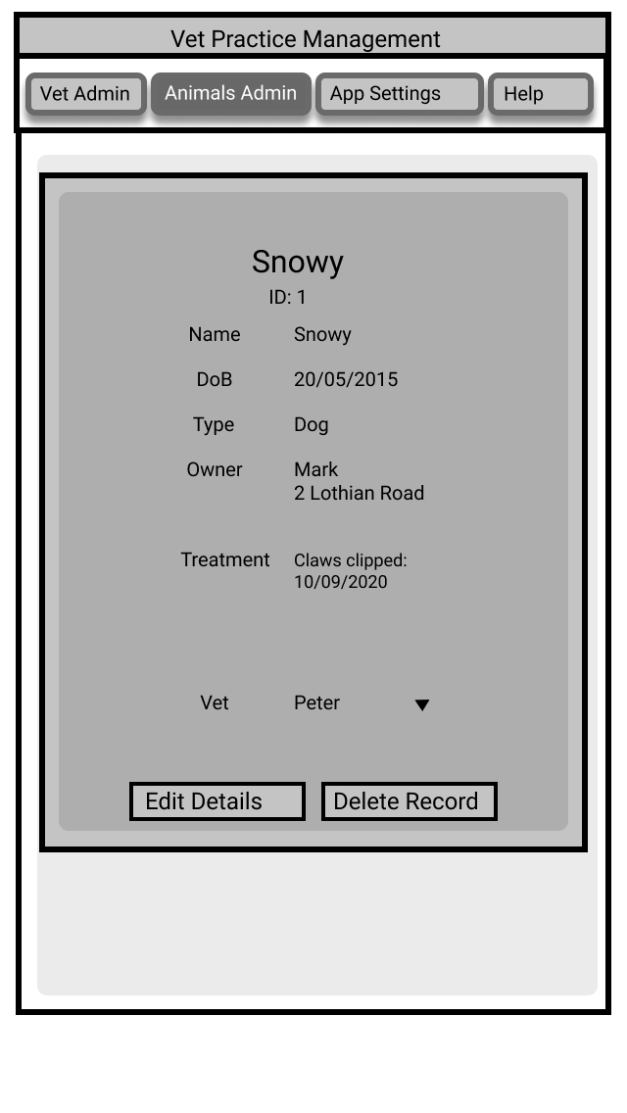
Animal Admin Tab
Notes:
Figma looks complicated but so long as you dont try and go mad you can get a clicky working pretend app up in probably comparable time, i’ll post my link on slack, i’m certainly no expert though!

Slide 6
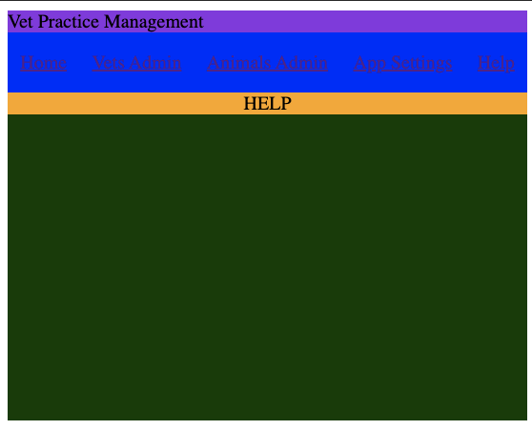
MVP 😂
🎉
🍾
Notes:
Like all our previous projects I set up a basic file and folder structure without flask or controllers yet, that would be later and got to work, referencing my db and models diagrams.
Writing tests, and using the console to test all my CRUD to the terminal, and populate the database for now and later resets in testing I imported flask and set it up.
When it came to flask, creating blueprints, controller routes and jinja templates this is where my figma prototype and my site-map became priceless. I had offloaded all the thinking involved in what to do where and most of the basic questions of html/css/layout.
I created a basic html document with lots of puke coloured boxes to test out my css skills and layout, and when i was happy with that, i sliced up the layout and transferred then relevant parts to their templates files.
This all worked remarkably well, yet I still feel I went through a lot of css-pain.

Slide 7
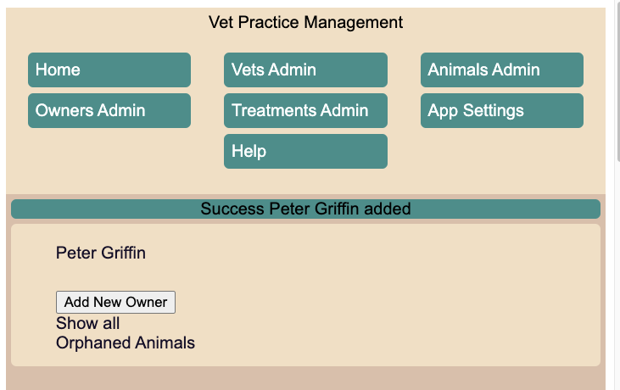
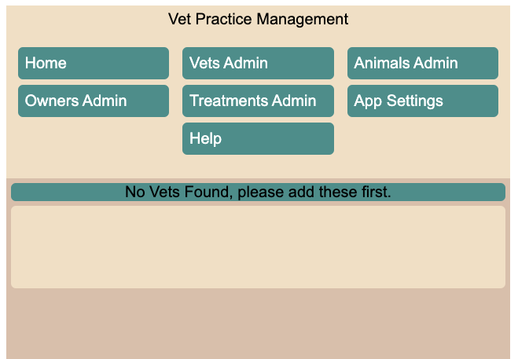
Small wins.
Site wide message bar
Guiding the user
Notes:
At this stage two things I was proud of:
The message system i had running site wide to feedback CRUD operations and more.
That my app recognised there were no vets in a new db instance yet, and wouldn’t let you create animals (hid the button) until this was fixed.

Slide 8


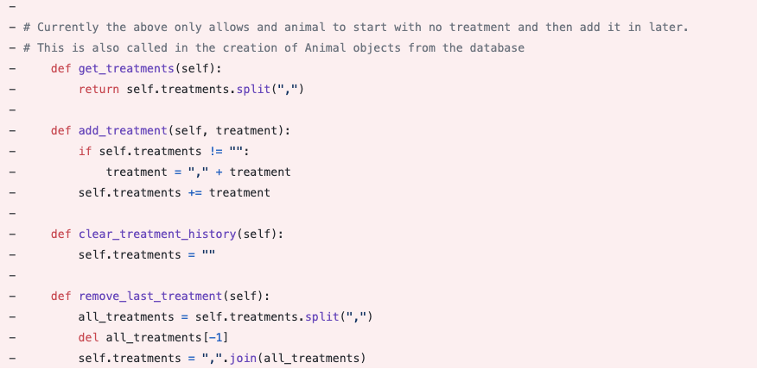
It’s good to know when to change tracks
Notes:
On monday I spent a lot of time implementing a treatments csv list which lived on the animal table, with methods and all sorts of crazy things, and whilst it worked, it wasnt as flexible or as easy to code around as i’d wanted. So it was a tough decision but i scrapped all of it….

Slide 9
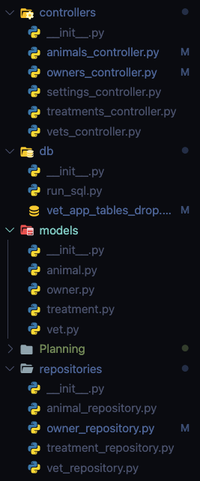
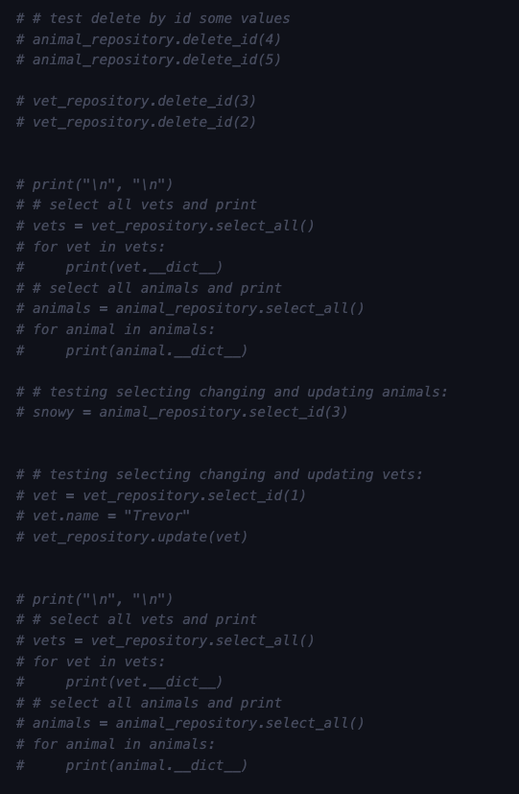
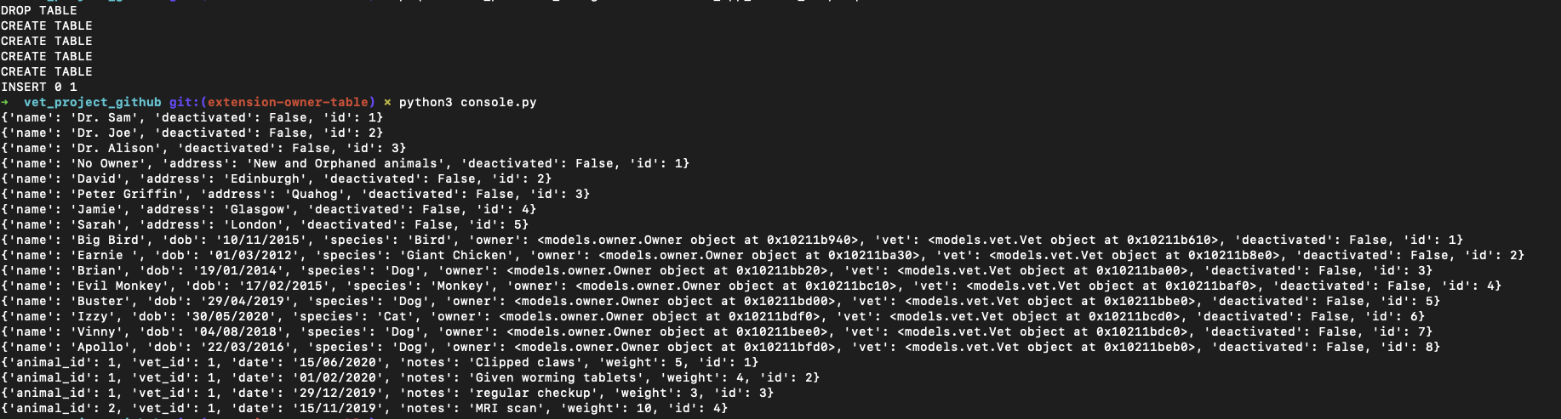
Testing my mayhem with the console was key to trusting it in the front end.
Notes:
And implemented two new tables, one to track treatments against vets and animals, and one to track owners of the animals, so the animals could be grouped, finally added deactivated to all tables because if i’m going to break it, i might as well go out in style?
TDD and this console style of pseudo TDD has really clicked with me, and its allowed me to take much bigger jumps in code knowing that i’ve got my own back assuming I wrote my tests correct and thoroughly originally. I couldn’t have even begun considering adding two tables, and changing the two existing without this, and branching! It was a long time before I essentially on the website had a working app with apparently no extra features, but i knew they worked under the hood, and it was a case of methodically fixing and adding routes, and templates to reflect this.

Slide 10

Refactoring & small ideas, big changes
I worked on a deactivate button
Logic was changed to create a No Owner concept.
Now new animals start with no owner, and deactivated owners move animals to no owner.
Which lead to a show all / active view site wide.
And logic to stop vets deactivating with animals assigned
So an orphan section was created for these animals to be assigned
Don’t underestimate that little idea!
Notes:
Deactivate idea is simple in theory (column on a db, right?), but tricky in execution, only when you realise your sitewide select_all is literally everywhere, And you need to refactor and consider how to create new repo functions and select active only, and then use them along with a “show all” button, routes management and arguments. Also this has to be replicated in to edit drop down menus and in the new Orphan page, which was spun out of deactivating Owners!

Slide 11
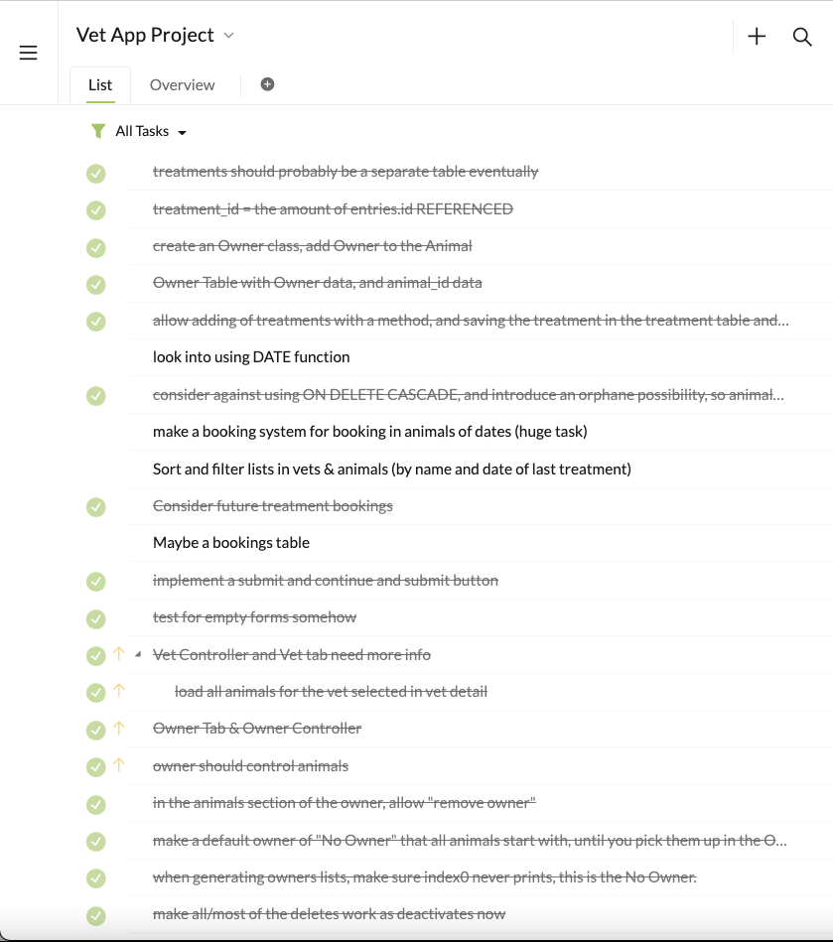
Things i’m pretty happy with now...
Things that could be better now its working...
Nested Jinja blocks, and less repeated code
Sensible and obvious logic allowing correct use and displayed objects
Some interesting use of Routes, with many GET and POST requests
Overuse of if elif in many Routes
Layout UX hints and styles such as colours on nav bar buttons etc...
Implement dates in the db and across the site properly
Tracking and plotting the weight of the animals from the treatments
Filters in the treatments page
Notes:
I’m pretty proud of how i have nested a few jinja blocks together to create dynamic pages, such as treatments in aminals, and the logic behind checking if something can be done before doing it, or catching edge cases such as disallowing animals with deactivated owners. These all required new functions and SQL calls referencing the deactivated attribute, which runs a lot deeper than you’d think!
The website is fully functional, and you are welcome to give it a try and point out all the things i’ve missed and how broken it is!

Slide 12

Questions?
Any particular feature you’d like to see in code?
Questions about logic?
Jinja Templates?
Anything obvious i’ve missed?
Notes:
I can show you code you might want to see and talk it through quick or later.
I can get my site up live quickly.
I can show you my figma prototype.
Cheers

